Slide 1
Module-B-Computation
Variables
Basic Memory Operations
Expressions

Slide 2
Objectives (1)
Variables
  Data Types
  Integral Types
  Floating-Point Types
  Declarations
Basic Memory Operations
  Constants
  Assignment Operator
  Output
  Input

Slide 3
Objectives (2)
Expressions
  Arithmetic
  In-Class Problem
  Arithmetic
  Relational
  Logical
  Shorthand Assignment Operators
  Mixing Data Types
  Casting
  Precedence

Slide 4
Variables
A variable is a name reference to a memory location, holds data that can change in value during the lifetime of the variable.
The C language associates a data type with each variable. Each data type occupies a compiler-defined number of bytes.

Slide 5
Data Types
Typed languages, such as C, subdivide the universe of data values into sets of distinct type.
A data type defines:
  how the values are stored and
  how the operations on those values are performed.

Slide 6
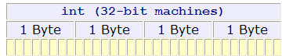
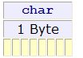
Primitive Data Types (1)
C has four primitive data types: int, char, float and double
An int occupies one word and can store an integer. On a 32-bit machine, an int occupies 4 bytes:
A char occupies one byte and can store a character or a symbol:

Slide 7
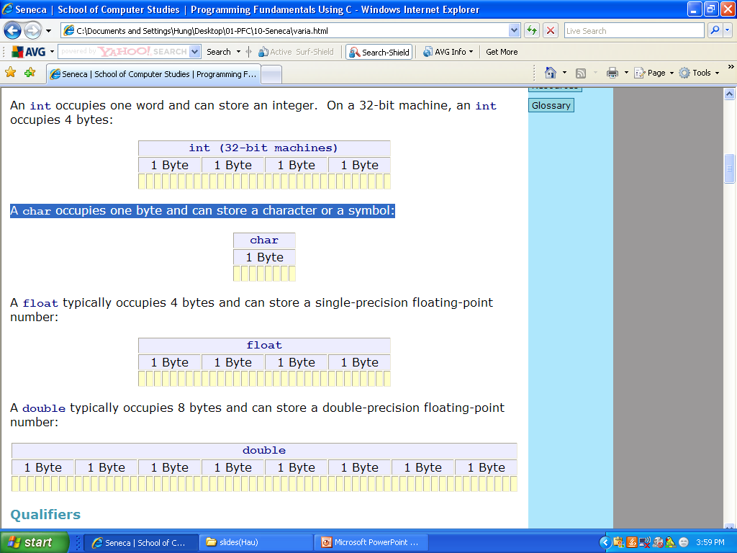
Primitive Data Types (2)
A float typically occupies 4 bytes and can store a single-precision floating-point number:
A double typically occupies 8 bytes and can store a double-precision floating-point number:

Slide 8
Qualifiers
We can qualify the int data type so that it contains a minimum number of bits.
Qualifiers:
  short :at least 16 bits
  long: at least 32 bits
  long long (__int64): at least 64 bits
Standard C does not specify that a long double must occupy a minimum number of bits, only that it occupies no less bits than a double.

Slide 9
Representation of Integral Values
C stores integral values in equivalent binary form.
Non-Negative Values
  Intel use this little-endian ordering.
  Motorola use big-endian ordering.

Slide 10
In-class practice
Convert the following decimal integers to binary:
63 __________________________________
219 _________________________________
Convert the following binary notation to decimal: 0111 0101 ___________________________
0011 1011 ___________________________
0011 1111
1101 1011
117
59

Slide 11
Negative and Positive Values
Computers store negative integers using encoding schemes:
  two's complement notation,
  one's complement notation, and
  sign magnitude notation.
All of these schemes represent non-negative integers identically.
The most popular scheme is two's complement.

Slide 12
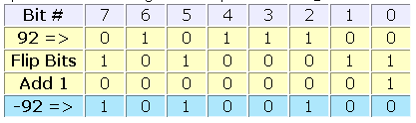
Two's complement notation
To obtain the two's complement of an integer, we
  flip the bits
  add one
For example:

Slide 13
In-class practice
What is the two's complement notation of
-63____________________________
-219___________________________

Slide 14
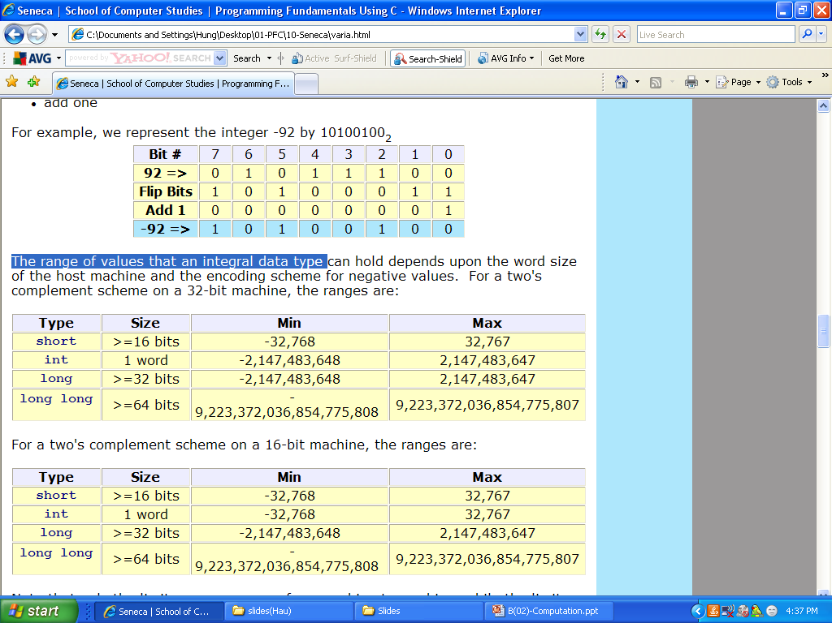
The range of values of an integral data types
For a two's complement scheme on a 32-bit machine, the ranges are:
For a two's complement scheme on a 16-bit machine, the ranges are:
Note that only the limits on an int vary from machine to machine, while the limits on a short, long, and long long do not vary.

Slide 15
Unsigned ints
We can use all of the bits available to store the value of a variable.
  unsigned short
  unsigned int
  unsigned long
  unsigned long long
With unsigned variables, there is no need for a negative-value encoding scheme.

Slide 16
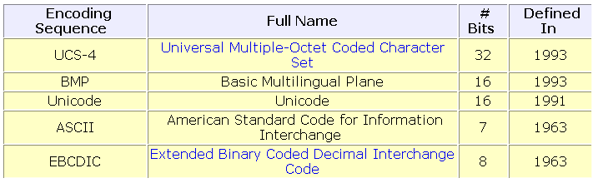
Encoding sequences
Although cultural symbols have no intrinsic numerical representation, we associate each symbol with a unique integer. We call such associations encoding sequences.
We store a symbol by storing the integer associated with the symbol.
Over 60 encoding sequences have already been defined.
We use the ASCII encoding sequence throughout this course

Slide 17
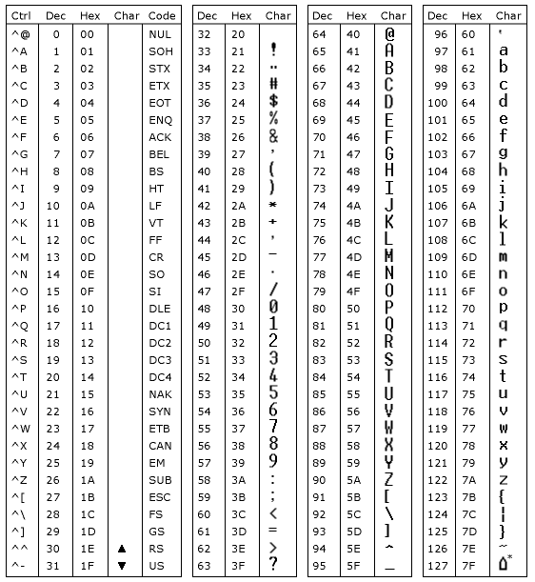
ASCII

Slide 18
In-class practice
What is the ASCII encoding for
  '0' ___________________________________________
  'a' ___________________________________________
  'A' ___________________________________________
Convert the following binary notation to an ASCII character:
  0110 1101 _____________________________________
  0100 1101 _____________________________________

Slide 19
Representation of floating-point data (1)
Computers store floating-point data using two separate components:
  an exponent and
  a mantissa

Slide 20
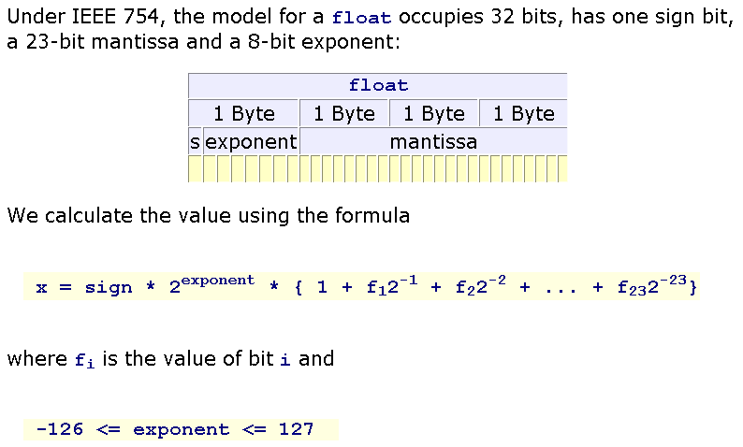
IEEE 754, 32 bits float…

Slide 21
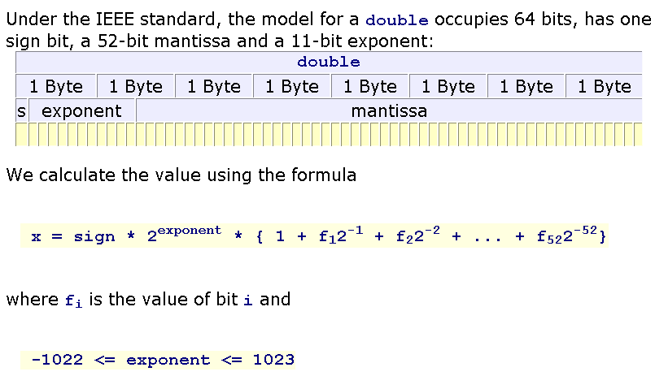
IEEE 754, 64 bits double…

Slide 22
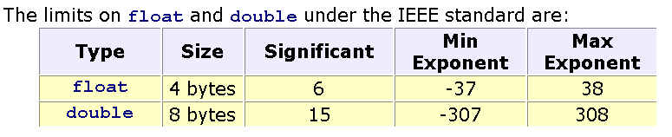
Representation of floating-point data (2)

Slide 23
Declarations (1)
data_type identifier [= initial value];
For example:
  char section;
  int numberOfClasses;
  double cashFare = 2.25;
char section, letter, initial, answer;
int numberOfClasses, children, books, rooms;
double cashFare, money, height, weight;

Slide 24
Declarations (2)
Naming Conventions
  must start with a letter or underscore (_)
  may contain any combination of letters, digits and underscore (_)
  must not be a C reserved word
  Some compilers allow more than 31 characters, while others do not. To be safe, we avoid using more than 31 characters.

Slide 25
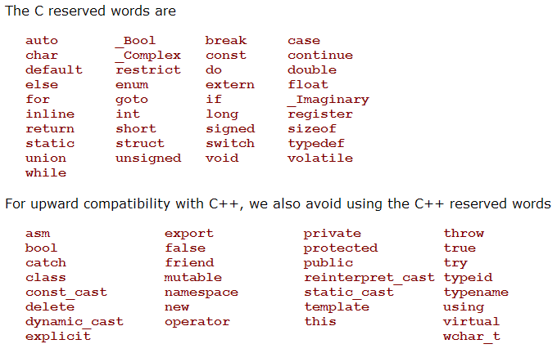
Reserved words

Slide 26
In-Class Practice
Which of the following is an invalid identifier:
  whale giraffe's camel_back 4me2 _how_do_you_do senecac.on.ca digt3 register
Select a descriptive identifier for and write a complete declaration for:
  A shelf of books__________________________
  A cash register___________________________
  A part time student_______________________
  A group of programs______________________

Slide 27
Summary
Variables
  Data Types
  Integral Types
  Floating-Point Types
  Declarations
Q&A

Slide 28
Basic Memory Operations
The C compiler allocates space for program variables in primary memory.
We work with variables in four principal ways. For example, we can
  assign a constant value to a variable,
  assign the value of another variable to a variable,
  output the value of a variable,
  input a fresh value into a variable's memory location.

Slide 29
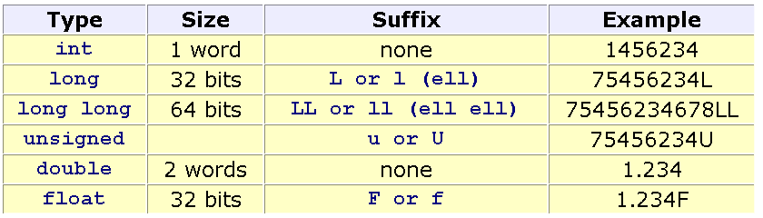
Constants (1)
The compiler embeds constants directly into the program instructions and does not allocate memory for constants.
Numeric
  We identify the data type of a numeric constant by a suffix

Slide 30
Constants (2)
Character
4 ways:
  the character itself enclosed in single quotes - for example 'A',
  the corresponding decimal value in the encoding sequence - for example 65 for 'A',
  the corresponding hexadecimal value in the encoding sequence - for example 0x41 for 'A', or
  the corresponding octal value in the encoding sequence - for example 0101 for 'A'.

Slide 31
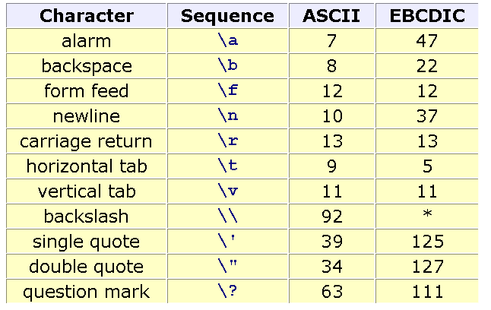
Constants (3)
Escape Sequences
We represent special actions or characters that are difficult to write directly by escape sequences:

Slide 32
Constants (4)
Literal Strings
We represent a literal string by enclosing it in double quotes.
For example,
“FPT University\n"

Slide 33
Assignment Operator
We use the assignment operator to store a value in a program variable.
variable = variable, constant or expression
= is the assignment operator
For example:
  int age;
  age=18;
  The assignment operator is unidirectional.
  The left operand must be a variable
  4 = age; /* ERROR */

Slide 34
Input & Output
A C program usually contains statements like #include ... at the beginning. e.g.
#include <stdio.h>
This is a preprocessor command. stdio.h is a file and is called the header file, which contains the macros for many of the input/output functions
used in ‘C’

Slide 35
Formatted output (1)
printf( format string , variable , ... , variable );
  The format string itself consists of the characters to be displayed interspersed with conversion specifiers. There should be as many variables listed after the format string as there are conversion specifiers.

Slide 36
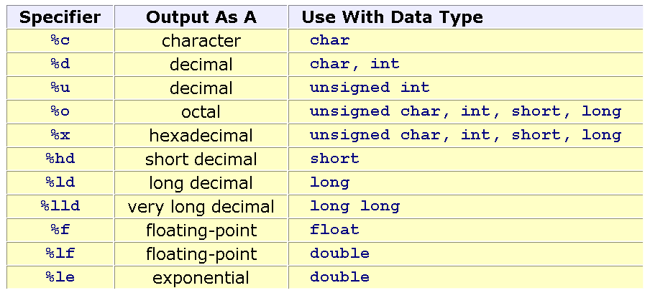
Formatted output (2)
Conversion Specifiers: All conversion specifiers begin with a % symbol. Each specifier describes how the corresponding variable is to be formatted on display:

Slide 37
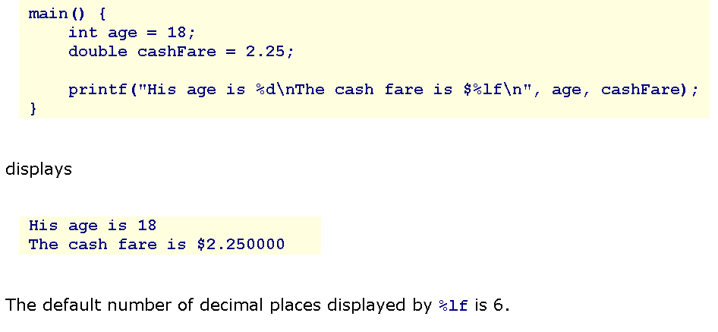
Output Example

Slide 38
Formatted input
scanf( format string , address , ... , address );
  The format string is a literal string. After the format string, we list the memory address of each variable into which we want the input stored. The prefix & denotes 'address of'.
  For example: scanf( "%d" , &age);

Slide 39
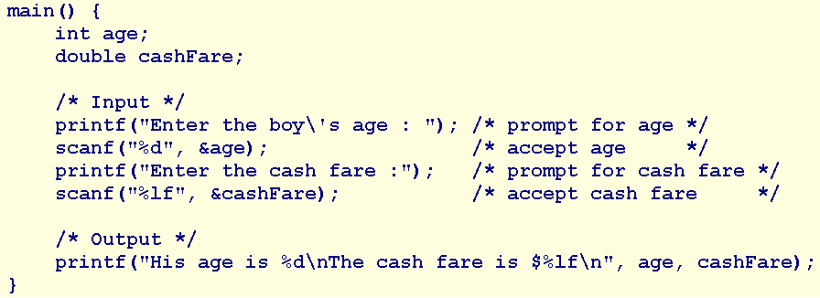
Input/Output Example

Slide 40
In-class practice
Write a program that prompts the user for the amount of money in their pockets, accepts the user input, and displays the amount in the format shown below. If the user enters 4.52, your program displays
How much money do you have in your pockets ? 4.52 The amount of money in your pockets is $4.52

Slide 41
Summary
Basic Memory Operations
  Constants
  Assignment Operator
  Output
  Input
Q&A

Slide 42
Expressions (1)
A simple expression consists of an operator and operand(s).
A compound expression consists of several operators and several operands.
The operands may be variables, constants and/or other expressions.
Any expression evaluates to a single value, to which we may refer on the right side of an assignment.

Slide 43
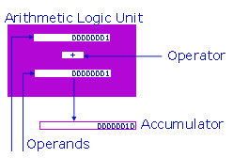
Expressions (2)
The compiler translates all expressions into sets of simple instructions that the Arithmetic Logic Unit (ALU) can process.
The ALU can only evaluate the simplest expression that consist of an operator and one or two operands. If there are two operands, they must be of identical data type.
The ALU receives the operator from the Control Unit. The operator may be
  arithmetic,
  relational or
  logical.
The operands are data values stored in the registers. The ALU places the result of the operation in the accumulator (the AX register). The data type of the result is the data type of the operand(s) of the operation.

Slide 44
Arithmetic Expressions (1)
Integral Data Types
The int and char data types accept 5 binary and 2 unary arithmetic operators:
  Binary: +, -, *, /, %
  Unary: +, -
  The division operator { / } yields a truncated integer result. That is, division of one integer by another yields the whole value without the remainder. For the remainder from an integer division, we use the modulus operator, %. Consider a room full of 1034 people to be divided into groups of 10:
  1034 / 10 /* yields 103 groups of 10 */
  1034 % 10 /* yields 4 people left over */
Floating-point Data Types
The int and char data types accept 4 binary and 2 unary arithmetic operators (% not included)
  Binary: +, -, *, /
  Unary: +, -

Slide 45
Arithmetic Expressions (2)
Division typically uses more resources. To avoid division, we multiply rather than divide. To avoid division, we multiply by 0.5 rather than divide by 2.0
Moreover, we prefer integral operations to floating-point ones.

Slide 46
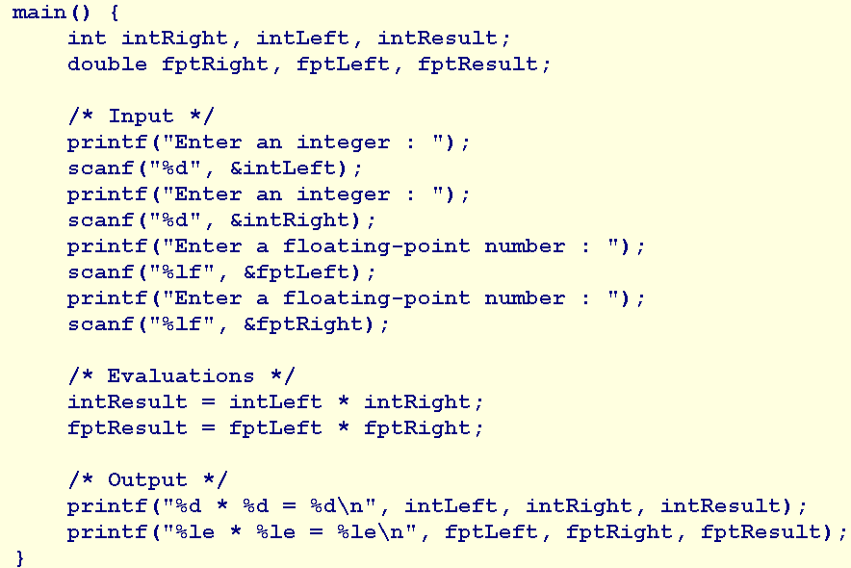
Expressions Example

Slide 47
Relational Expressions
Relational expressions compare values and represent conditions with a true or false result.
The C language interprets the value zero as false and any other value as true.
Each primitive data type admits 6 relational operators for comparing values of that data type to other values of the same data type.
Operators: == > >= < <= !=

Slide 48
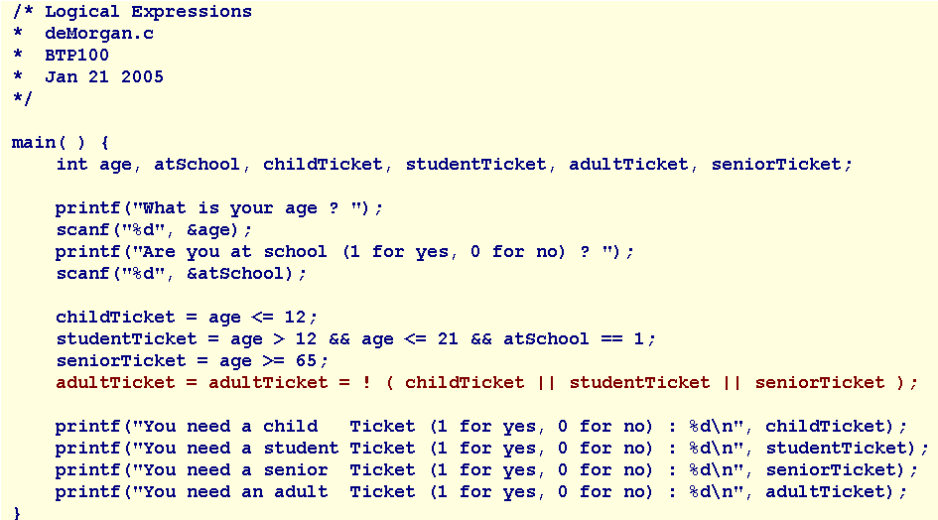
Relational Expressions Example

Slide 49
Logical Expressions
Logical expressions compare conditions and yield true or false results.
We use logical operators to express compound conditions.
The C language has 2 binary logical operators and 1 unary operator.
Operators: && || !

Slide 50
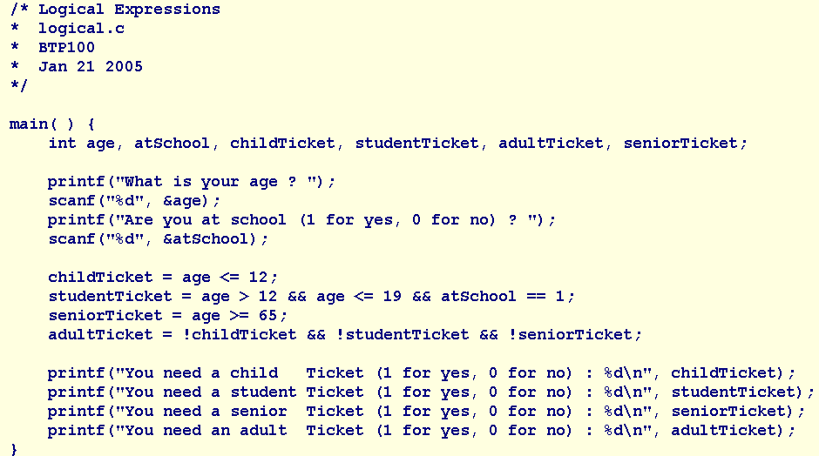
Logical Expressions Example

Slide 51
Shorthand Assignment Operators (1)
The C language includes a set of shorthand assignment operators, which combine arithmetic expressions with assignments.

Slide 52
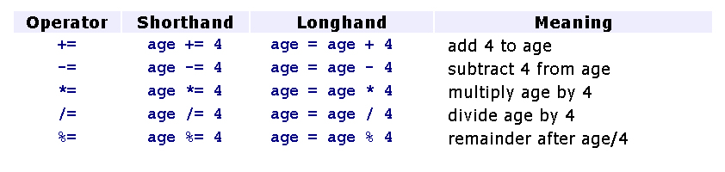
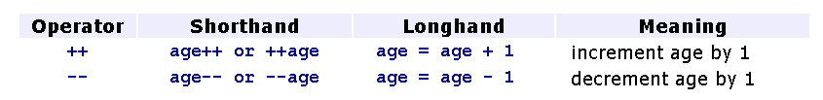
Shorthand Assignment Operators (2)
The pre-fix operator changes the value of the operand before the value is used, while the post-fix operator changes the value of the operand after the value has been used.

Slide 53
Mixing Data Types (1)
Although the ALU does not perform operations on operands of differing data type directly, C compilers can interpret expressions that contain operands of differing data type.
If a binary expression contains operands of differing type, a C compiler changes the data type of one of the operands to match the other.

Slide 54
Mixing Data Types (2)
Data type hierarchy:
  double higher
  float ...
  long ...
  int ...
  char lower

Slide 55
Mixing Data Types (3)
Assignment Expressions
If the data type of the variable on the left side of an assignment operator differs from the data type of the right side operand, the compiler
  promotes the right operand to the data type of the left operand if the left operand is of a higher data type than the right operand,
  truncates the right operand to the data type of the left operand if the left operand is of a lower data type than the right operand.

Slide 56
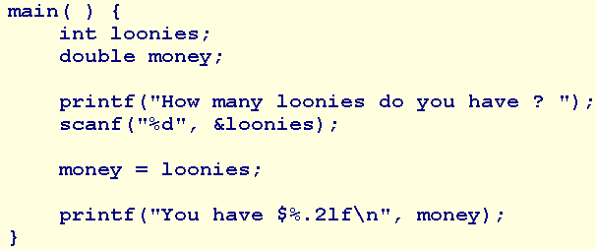


Mixing Data Types Example

Slide 57
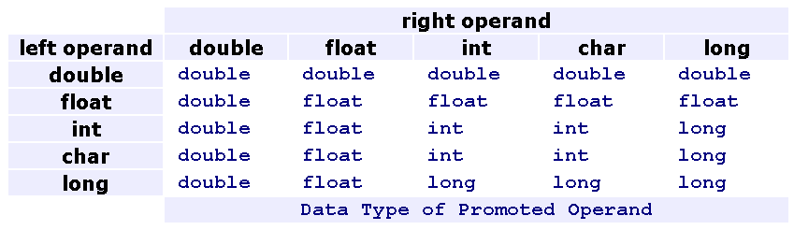
Mixing Data Types (4)
Arithmetic and Relational Expressions
If the operands in an arithmetic or relational expression differ in data type, the compiler promotes the value of lower data type to a value of higher data type before implementing the operation.

Slide 58
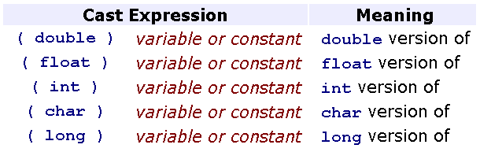
Casting
We may temporarily change the data type of any operand in any expression to obtain a result of a certain data type.

Slide 59
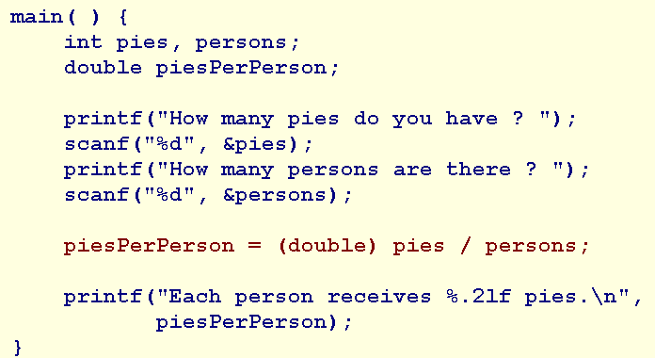

Casting Example

Slide 60
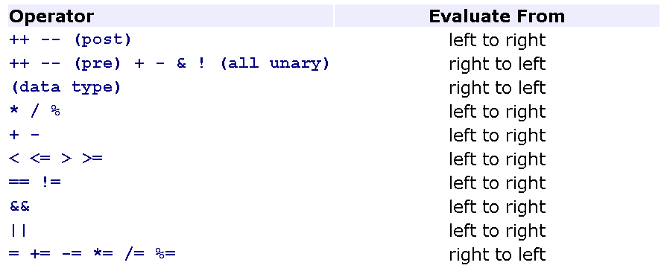
Precedence
The rules of precedence define the order in which a compiler must decompose a compound expression.
The compiler evaluates the first operation with the operator that has highest precedence.
Use ( ) to instruct the compiler to evaluate the expression within the parentheses first

Slide 61
Summary
Expressions
  Arithmetic
  In-Class Problem
  Statistics
  Relational
  Logical
  Shorthand Assignment Operators
  Mixing Data Types
  Casting
  Precedence
Q&A

